Slide 1
Threat Actors
Chapter 07

Slide 2
Script Kiddies
Unskilled attackers
Use existing tools and scripts
Do not fully understand tools
Motivated by ego or recognition

Slide 3
Hacktivists
Motivated by political or social causes
Target organizations or institutions
Common attacks
Defacement
Data leaks
DoS attacks
Driven by activism goals

Slide 4
Organized Crime
Financially motivated groups
Highly sophisticated attacks
Activities include
Data theft
Extortion
Identity theft
Focus on profit

Slide 5
Advanced Persistent Threats (APT)
State-sponsored attackers
Highly advanced techniques
Long-term targeting
Motivated by national interest

Slide 6
Competitors as Threat Actors
Seek market advantage
Target rival organizations
May steal information
May disrupt services

Slide 7
Insider Threats
Originate within organization
May be malicious or accidental
Disgruntled employees possible
Can cause internal damage

Slide 8
Shadow IT Risks
Unauthorized IT usage
Not managed by IT team
Can impact security and availability
Introduces unknown risk

Slide 9
ttps
Chapter 07

Slide 10
TTPs and Attribution
Link actions to threat actors
Identify attack patterns
Track adversary behavior
Support incident analysis

Slide 11
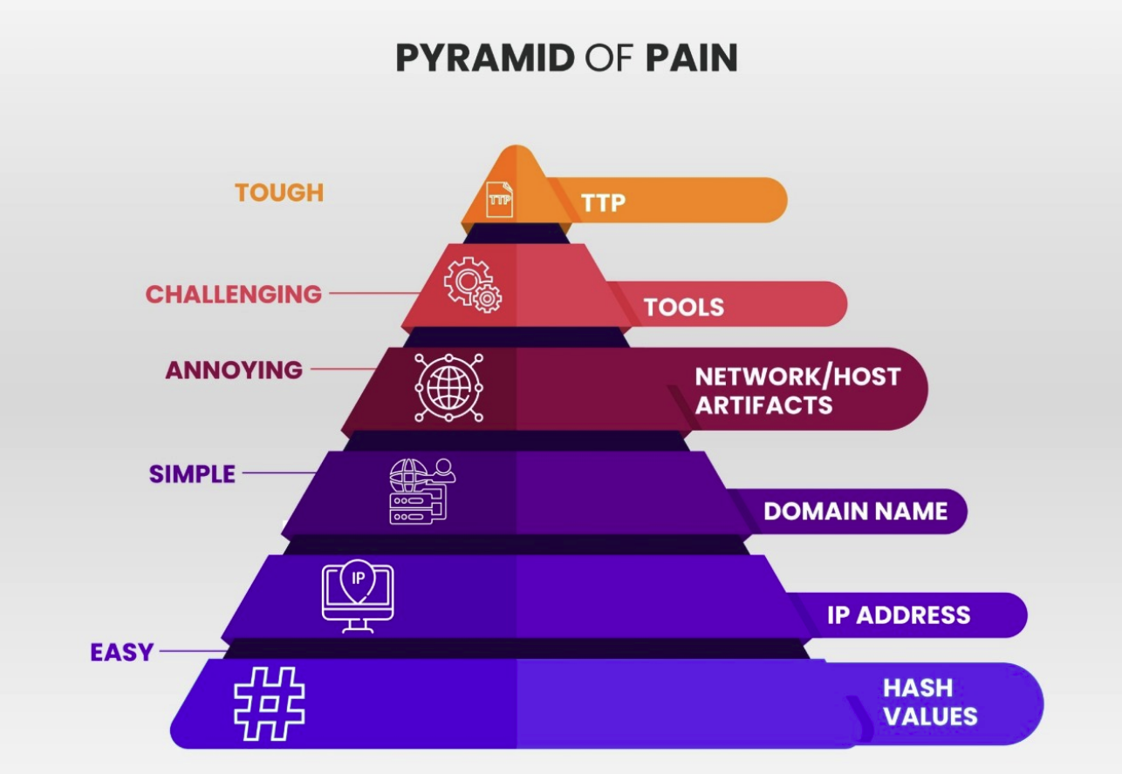
Pyramid of Pain

Slide 12
Pyramid of Pain
Hierarchy of attack indicators
Lower levels easier to change
Higher levels harder to evade
Focus on attacker disruption

Slide 13
Indicators vs TTPs
Lower indicators
IPs hashes easily changed
Higher indicators
Tools and TTPs harder to evade
Higher disruption to attackers
Focus on long-term impact

Slide 14
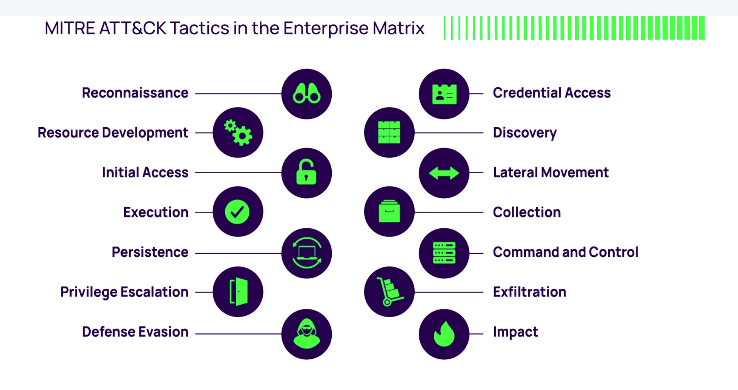
MITRE ATT&CK Framework

Slide 15
MITRE ATT&CK Framework
Knowledge base of adversary behavior
Maps real-world attack patterns
Based on TTPs
Used for analysis and defense

Slide 16
Using ATT&CK
Identify potential adversaries
Map activity to patterns
Analyze systems and processes
Support defensive planning

Slide 17
Attribution Using TTPs
Link attacks to groups
Use behavioral clues
Identify campaigns
No claim needed

Slide 18
TTP Behavioral Patterns
Unique attacker behaviors
Repeated identifiable actions
Create recognizable signatures
Used to track actors

Slide 19
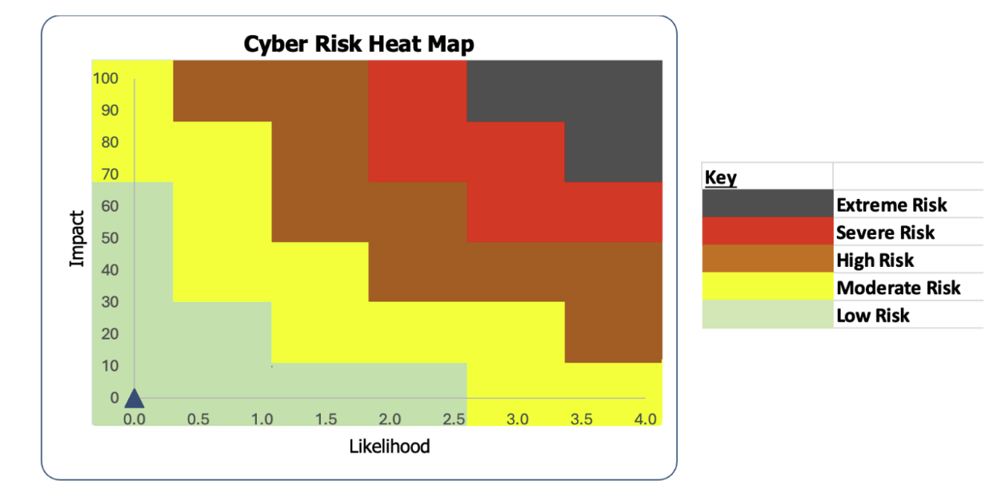
Heat Map

Slide 20
Heat Map Analysis
Visualizes attacker behavior
Predicts likely next steps
Shows detection coverage
Identifies security gaps

Slide 21
TTPs in Defense Strategy
Use Intelligence from past attacks
Identify likely adversaries
Build proactive defenses
Improve threat response

Slide 22
Intel Sources
Chapter 07

Slide 23
Open-Source Intelligence (OSINT)
Publicly available information
Accessible to anyone
Wide range of sources
Collected from open web

Slide 24
OSINT Challenges
Large volume of data
Duplicate information common
Requires validation effort
Must separate fact from rumor

Slide 25
Closed Source Intelligence
Subscription-based services
Paid intelligence sources
Pre-analyzed information
Delivered to memebers

Slide 26
Closed Source Benefits
Reduces false information
Provides actionable data
Less manual analysis required
Improves efficiency

Slide 27
Intelligence Sharing Organizations
Share intelligence across groups
Support collaboration
Improve situational awareness
Enhance security response

Slide 28
ISAC, ISAO, and SIX
ISAC
Sharing and analysis center
ISAO
Industry collaboration
SIX
Information exchange groups
All support intelligence sharing

Slide 29
Intel Metrics
Chapter 07

Slide 30
Intelligence Evaluation Metrics
Intelligence must be evaluated
Uses defined metrics
Applied before analysis
Ensures usefulness of data

Slide 31
Relevance of Intelligence
Pertains to organization systems
Applies to current environment
Matches system versions
Determines operational impact

Slide 32
Accuracy of Intelligence
Measures reliability of data
Distinguishes rumor vs verified
Trusted sources improve accuracy
Higher accuracy increases value

Slide 33
Timeliness of Intelligence
Determines if intelligence is usable
Evaluates response window
Identifies outdated information
Supports timely action

Slide 34
Timeliness Example and Impact
Early warning before attack
Time to prepare defense
Improves response readiness
Enables preventive action

Slide 35
Cyber Threat Intelligence
Chapter 07

Slide 36
What Is Cyber Threat Intelligence?
Lessons learned from past attacks, applied to future defense
Turns suspicious activity into actionable insight
No CTI = flying blind

Slide 37
Data Enrichment
Adds context: geo data, TTPs, IPs, targeted systems
Raw data in, actionable intelligence out
Every enriched piece builds the bigger security picture

Slide 38
Intelligence Sharing Platforms
Platforms: OTX, MISP, OpenCTI
Feeds IOCs directly into SIEMs and vulnerability scanners
Today’s threat to them is tomorrow’s threat to you

Slide 39
Internal Reports and STRIDE
Org-specific reports from logs, network data, and threat feeds
STRIDE: Spoofing, Tampering, Repudiation, Info Disclosure, DoS, Privilege Escalation
Categorize the threat → pick the right control

Slide 40
Cyber Threat Maps
Live global attack visualizations (FortiGuard, Kaspersky)
Show source, destination, and attack type in real time
You never want to see yourself on one

Slide 41
Deception Tools
Honeypots: decoys that flag any traffic as suspicious
Honeynets: entire fake networks of VMs as bait
Observe attacker TTPs, then share intel with the community

